Slide 1


Adidas USA Marketing Analysis: 2020 and 2021
Sai Anudeep Janapareddy - W0836698
The presentation provides a comprehensive analysis of Adidas, exploring its brand history and market performance in the USA during 2020-2021. Through a detailed SWOT analysis and comparative study with Puma, the presentation highlights Adidas's strengths in brand recognition and global market presence. The data-driven insights from sales analysis, coupled with strategic recommendations, offer potential growth opportunities in the evolving sportswear industry.

Slide 2

Adidas Company Overview
Brand Identity
Founded in 1949 by Adolf Dassler, Adidas has established a strong brand identity rooted in its rich heritage and commitment to innovation, making it a leader in athletic performance apparel and footwear. The iconic three-stripe logo symbolizes excellence and is instantly recognizable worldwide.
Market Presence
Adidas has established a significant market presence in the USA, achieving a notable market share that has increased from 15.1% in 2020 to 18.1% in 2021. The brand is recognized as a major player in the sportswear industry, contributing approximately €3.1 billion in revenue in the first half of 2022 alone.
Product Portfolio
Adidas boasts a diverse product portfolio in the USA, primarily categorized into footwear, apparel, and accessories, catering to a wide range of sports and lifestyle needs. The brand is particularly renowned for its athletic footwear, with iconic lines such as the Ultraboost, Stan Smith, and Superstar leading sales.

Slide 3




SWOT Analysis of Adidas
Strong Brand Equity
Dependence on Outsourcing
E-commerce Growth
Intense Competition
Innovative Product Range
Rising Health Consciousness
Economic Downturns
Premium Pricing Strategy
Supply Chain Disruptions
Strategic Partnerships
Expansion into Emerging Markets
Narrow Product Line
Counterfeit Products
Commitment to Sustainability
Limited Market Penetration in Emerging Markets
Investment in Technology and Innovation

Slide 4

Adidas VS Puma
Adidas
Puma
Brand Origin
Founded in 1949 by Adolf Dassler in Germany. The brand is known for its iconic three-stripe logo and focus on high-performance sportswear
Founded in 1948 by Rudolf Dassler, Puma emerged from the same family split. The Puma name, symbolizes speed and agility.
As of 2021, Adidas had a brand value of over $14.3 billion, with net global sales amounting to $21.2 billion
As of 2021, Puma had brand value of $6.3 billion.
Market Value
Number of Outlets
There are 198 Adidas stores in the United States as of March 06, 2024.
There are 120 Puma stores in the United States as of November 15, 2024.
Market Share and
Customer Base
Holds a substantial market share as the second-largest sportswear company worldwide, Its customer base includes athletes and fashion-conscious consumers.
Puma is recognized as the third-largest sportswear manufacturer globally, It has a significant presence in motorsports and soccer.

Slide 5

Adidas Data Overview
Dataset Description
Purpose of Analysis
The dataset encompasses Adidas sales data in the USA for 2020 and 2021, capturing key sales metrics across various retailers and regions.
The analysis aims to identify sales trends and understand market dynamics to predict sales of new product launches.
Key Features
Expected Insights
It includes critical features such as Retailer, Invoice Date, Region, State, City, Product, Price per Unit, Units Sold, Total Sales, Operating Profit, Operating Margin, and Sales Method.
Key insights expected from the analysis include top-performing products, profitability metrics, and regional sales patterns that can guide future marketing strategies.

Slide 6
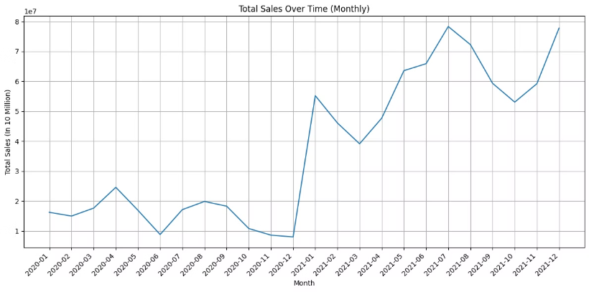
Insights from Data Analysis
Total Sales over Time
In 2020, sales started at 15 million dollars in January, peaked at 25 million dollars in April, and dipped to 10 million in June. From June to December, sales fluctuated between 10 million and 20 million dollars.
In early 2021, sales surged, peaking at 55 million dollars in January. The year experienced fluctuations, with notable peaks in June to August (both around 70 million) and a low in March at 40 million. Sales ended strongly in December 2021, reaching about 80 million dollars, highlighting significant growth trends throughout the year.
These insights indicate periods of growth and decline, highlighting significant trends such as the substantial increase in sales in early 2021 and the steady rise towards the end of the year.

Slide 7
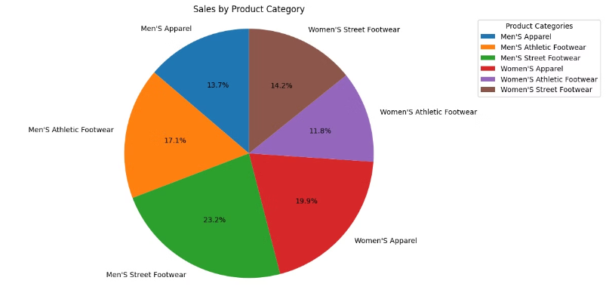
Sales by Product Category
Men's street footwear leads sales at 23.2%, while women's athletic footwear is the least popular at 11.8%.
Women's apparel holds a significant 19.9% share, making it the second most popular category.
Overall, the sales distribution is balanced, with footwear's importance evident as both men's and women's segments significantly contribute to total sales.

Slide 8

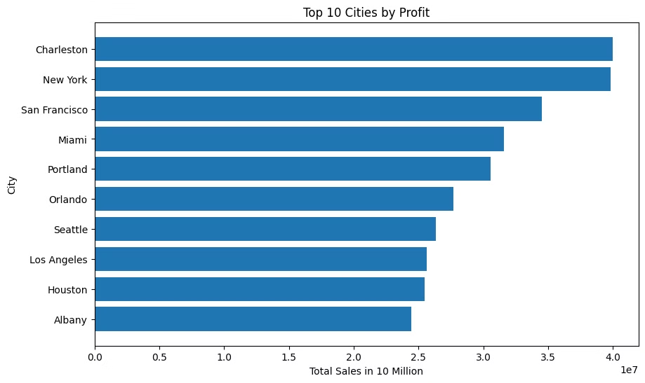
Top 10 Cities by Profit
Top Profitable Cities:
Charleston: Leads with nearly 40 million in total sales.
New York: Close behind, showcasing high profitability.
San Francisco and Miami: Both report significant profits.
Lowest Among Top 10:
Albany: Ranks lowest with just above 20 million in sales.
Business Strategy Implications: Identifying high-profit cities like Charleston and New York can guide decisions on market expansion and targeted marketing efforts.

Slide 9
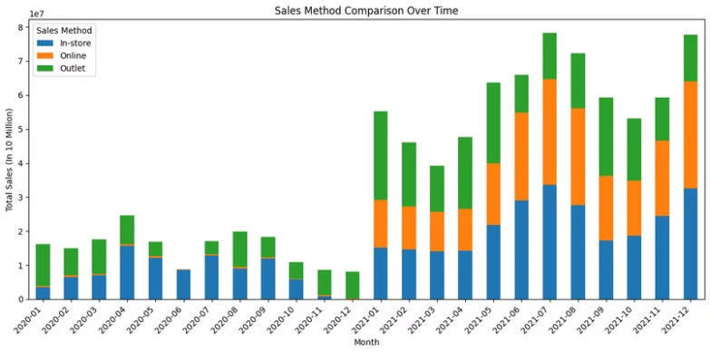
Sales Method Comparison Over Time
Sales trends show a significant increase, especially from early 2021.
In-store sales (blue bars) have remained steady, while online sales (orange) started small but gradually rose from mid-2020. Outlet sales (green) significantly contributed to total sales, particularly in the latter half of the period.
There were notable sales peaks in April 2020, January 2021, and July 2021, likely driven by seasonal factors or promotions. The rise in online sales correlates with the COVID-19 pandemic, which shifted consumer behaviour toward digital shopping.

Slide 10
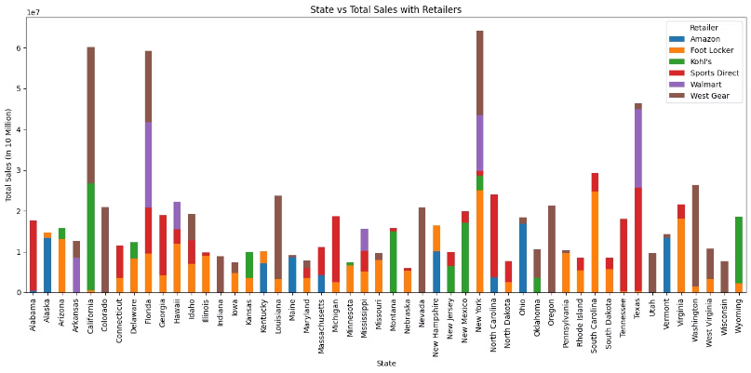
State vs Total Sales with Retailers
High Sales States: California, Florida, New York, and Texas lead in total sales, with California and Texas having the highest overall sales.
Dominant Retailers: West Gear (brown) is the dominant retailer in 10 states.
Retailer Distribution: Walmart (purple) shows significant sales in Florida, Texas, and New York.
Varied Retailer Presence: New York and Florida have diverse retailers, while other states have fewer options.
Low Sales States: Wisconsin, Nebraska, and North Dakota have relatively low total sales.

Slide 11




Recommendations
Focus marketing and sales efforts in Charleston and New York.
E-Commerce Platform
Focus on increasing the sales of Women’s Athletic Footwear
Enhance Product Availability
Enhance the user experience on their website and mobile app, ensuring seamless navigation, faster load times, and secure transactions.
This could be achieved through targeted marketing campaigns, product innovations, or collaborations with influencers and athletes that resonate with female consumers.
These cities show the highest profits, indicating a strong market presence and significant potential for further growth.
Ensure a wide range of Adidas products is available in West Gear stores, tapping into their established customer base.

Slide 12

Thank You

